Slide 1
Litter Recognition 1 - 14th March
Presented by Jude, Ryan, Jack, Hanzhong, and Sriram.

Slide 2
Top-Down Project Structure
From a top-down view, the goal of our project has been to create an autonomous system, using an arduino robot arm, that can pick up and identify different types of litter. This slide showcases the remaining ‘Epics’ of our project and our definition of done for each.
Remaining Epic | Definition of Done
Implement Inference Code | Real time object detection running on the pi cameras using our model.
Camera feed sent back to Raspberry Pi | Multi camera module working and sending back two camera feeds to the Pi.
Distance Calculation | Distance between the arm and litter correctly calculated.
Code to pick up litter | Arm picking up detected litter from an unspecified orientation.

Slide 3
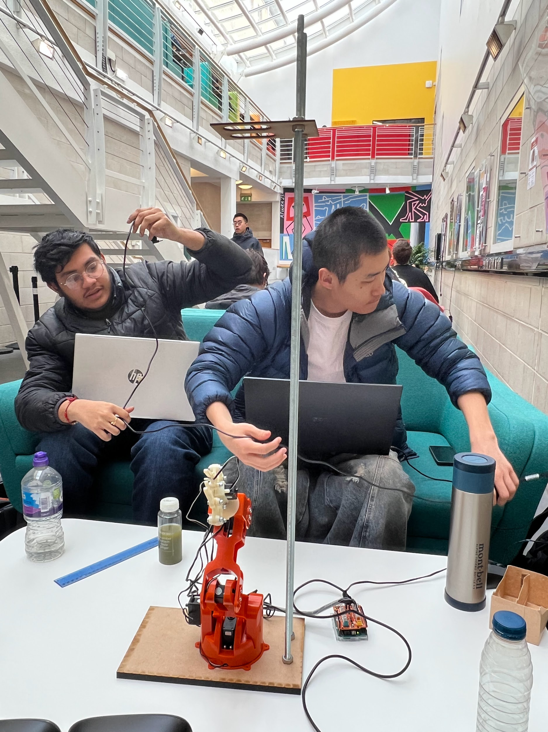
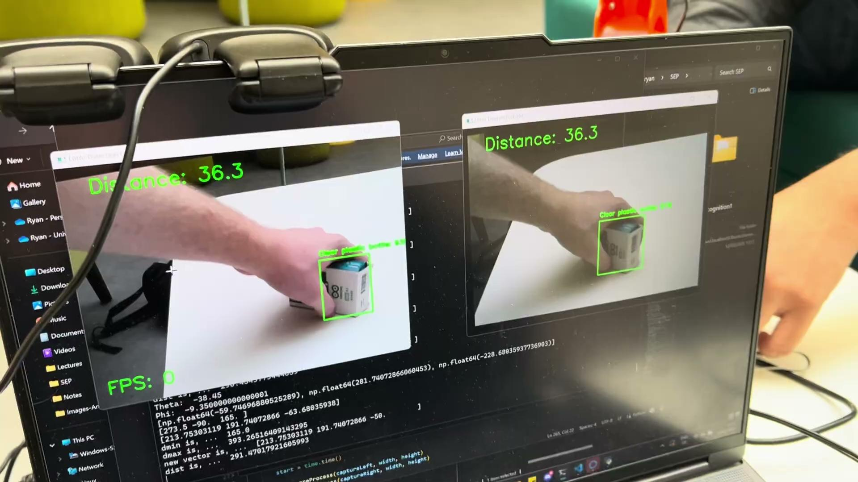
Autonomous System…

Slide 4


Slide 5
Ryan - Client Liaison
Started writing our handover documentation.
Deployed our handover documentation to GitHub pages.
Created our poster for the upcoming Client Celebration Day!
Helped the rest of group automate our system on Wednesday.

Slide 6
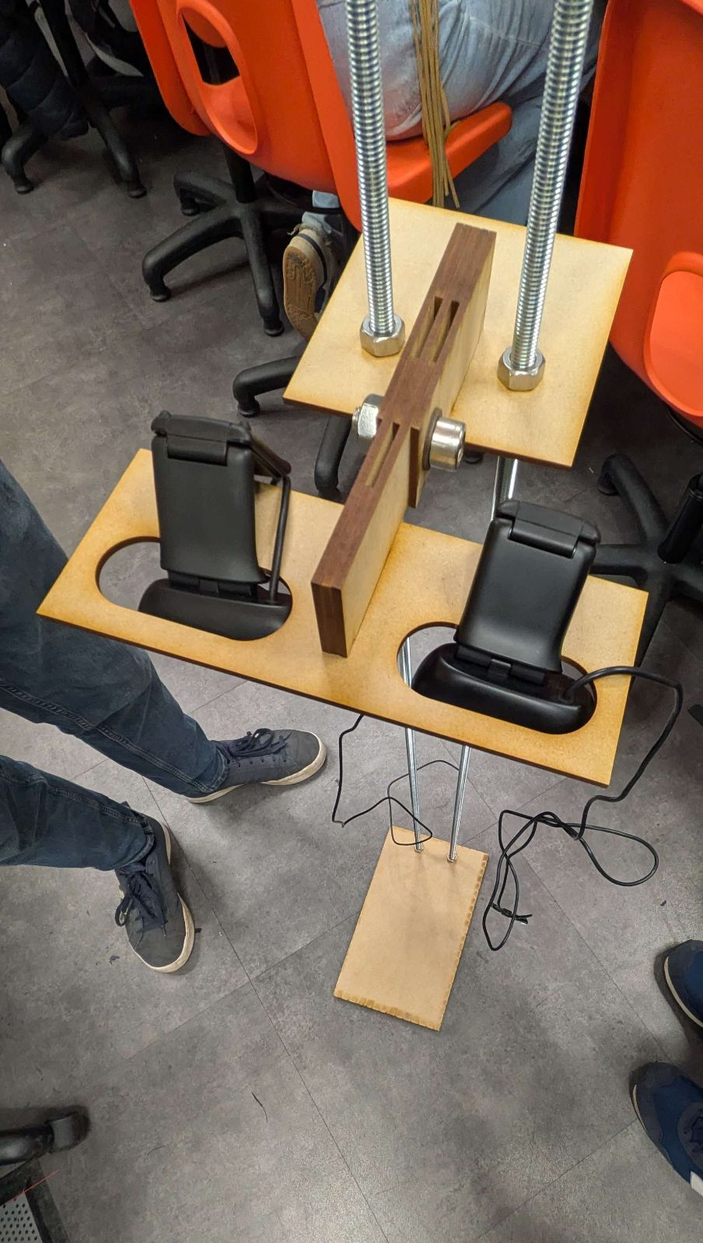
Jack
Wrote some tests for the inverse kinematics code
Created a stand to hold the cameras and robot
Very quickly wrote a way for our interface to support multiple modes of operating (manual vs automated)
Wrote some documentation

Slide 7
Sriram
Started writing handover documentation for the robot.
Created a debugging interface for our autonomous system.
Wrote litter classification code which classifies the detected litter into 2 bins.
Created a litter pickup method.

Slide 8
Hanzhong
Got a converter with assumption converting the depth into coordinate
Quickly fix path and import bug to ensure calls between files
Working on the log of litters that have been picked up
Working on documentation

Slide 9
Jude - Project Managing
Found and ordered extra usb cam of same model
Encountered unexpected issues with our cameras on the pi
Wrote some code to calculate object coordinates relative to robot from the output of our inference
Combined robot and camera code to make autonomous system

